Slide 1
Distinguishing Between Renewable and Non-Renewable Energy Resources
Understanding Vancouver's Energy Landscape

Slide 2
CONTENT
Distinguishing Between Renewable and Non-Renewable Energy Resources
Energy Sources in Vancouver
Transition to Renewable Energy
Local Strategies for Sustainable Energy
Acknowledgments

Slide 3
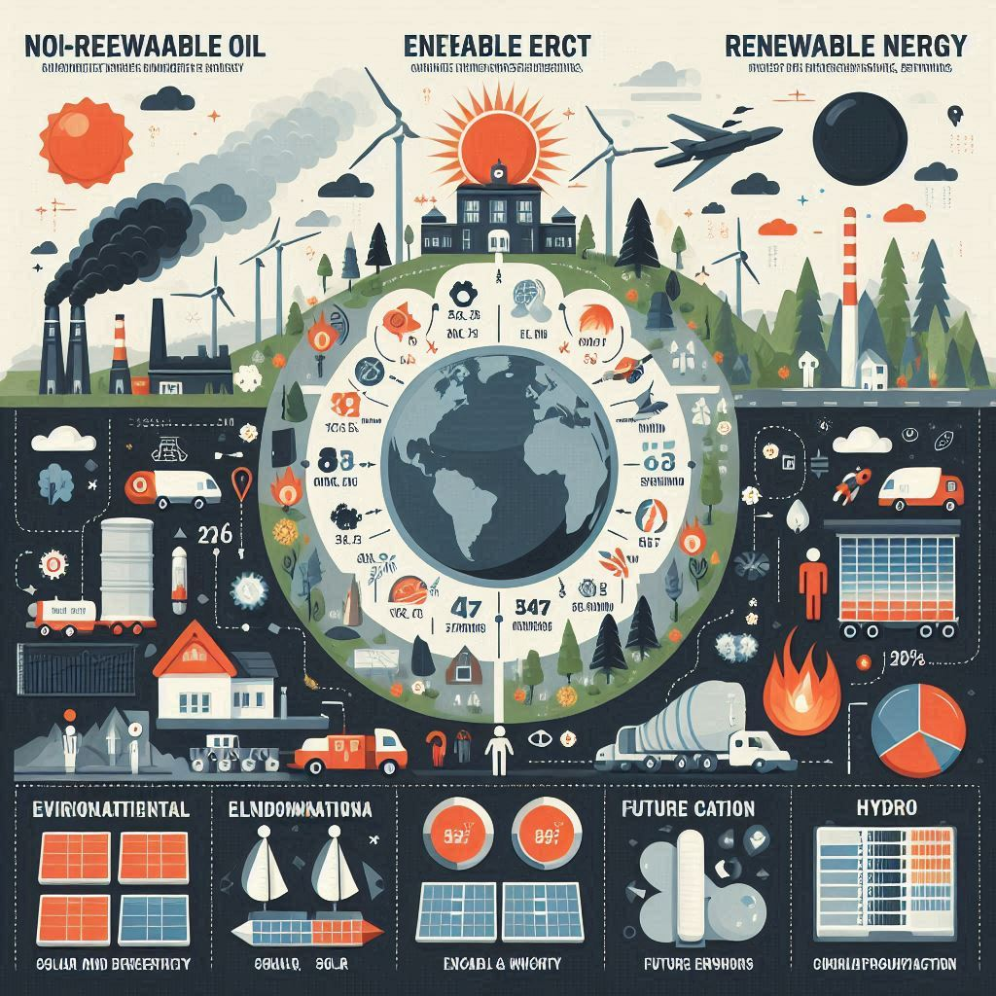
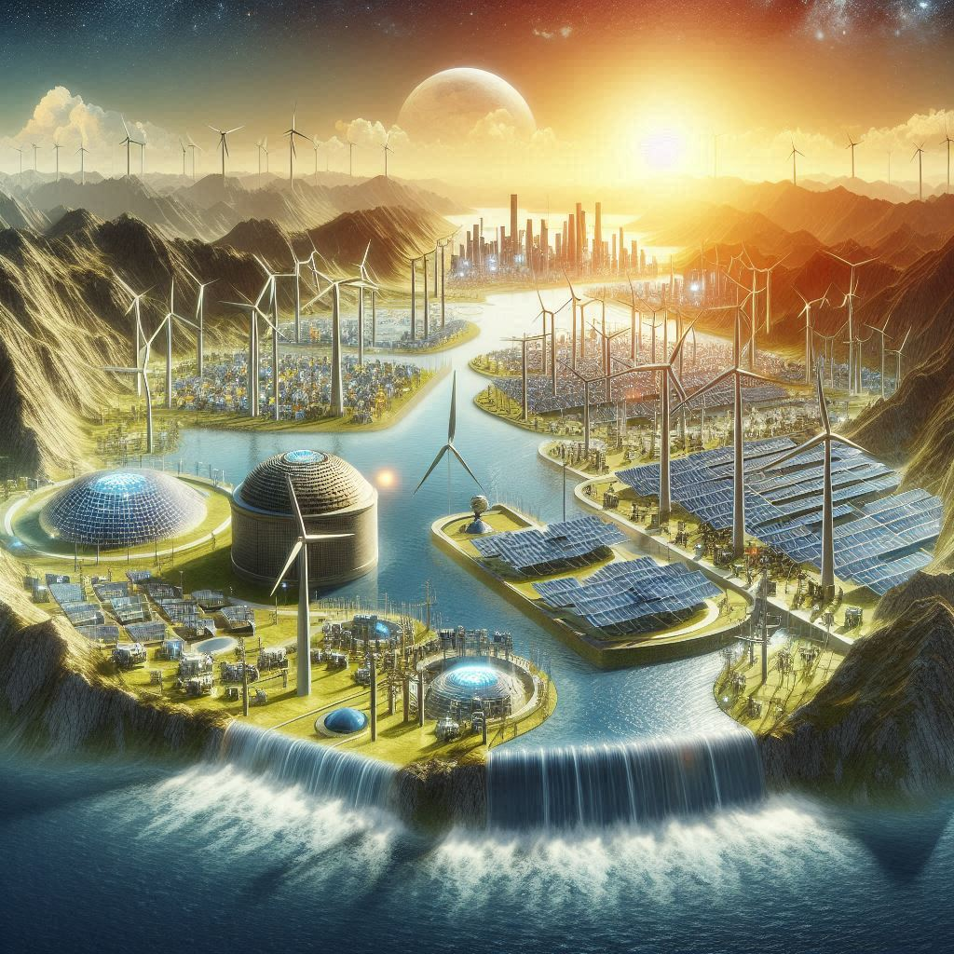
Distinguishing Between Renewable and Non-Renewable Energy Resources
Renewable Energy
Renewable energy sources are those that can be naturally replenished, such as solar, wind, hydro, and geothermal energy. These sources are abundant and environmentally friendly.
Non-Renewable Energy
Non-renewable energy sources include fossil fuels like coal, oil, and natural gas. These resources are finite and contribute to air pollution and climate change.

Slide 4
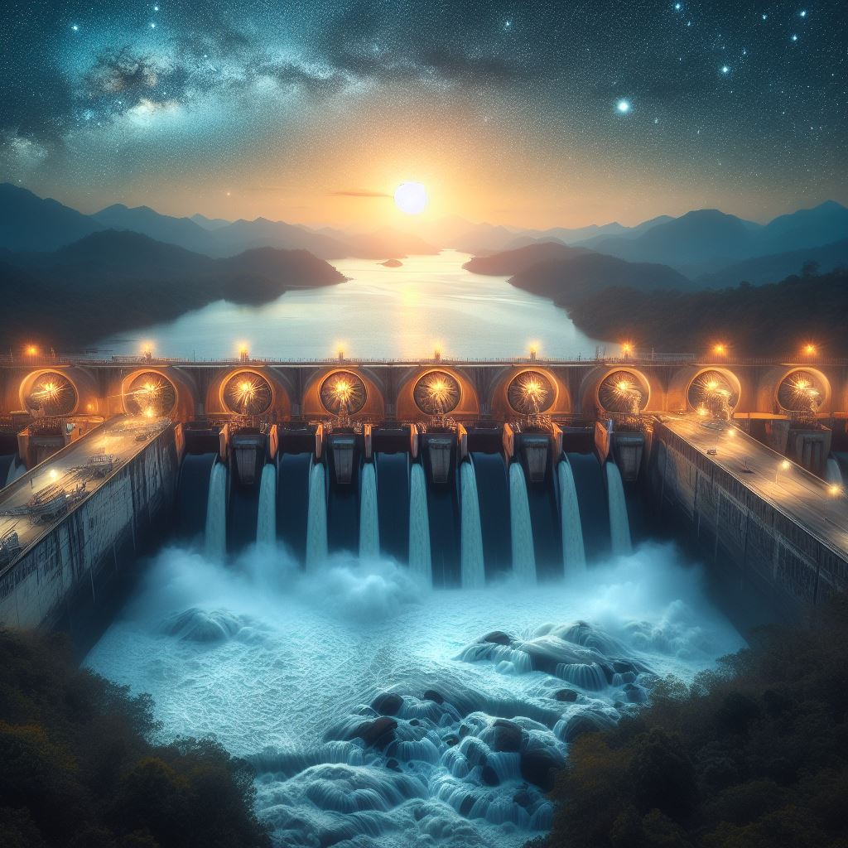
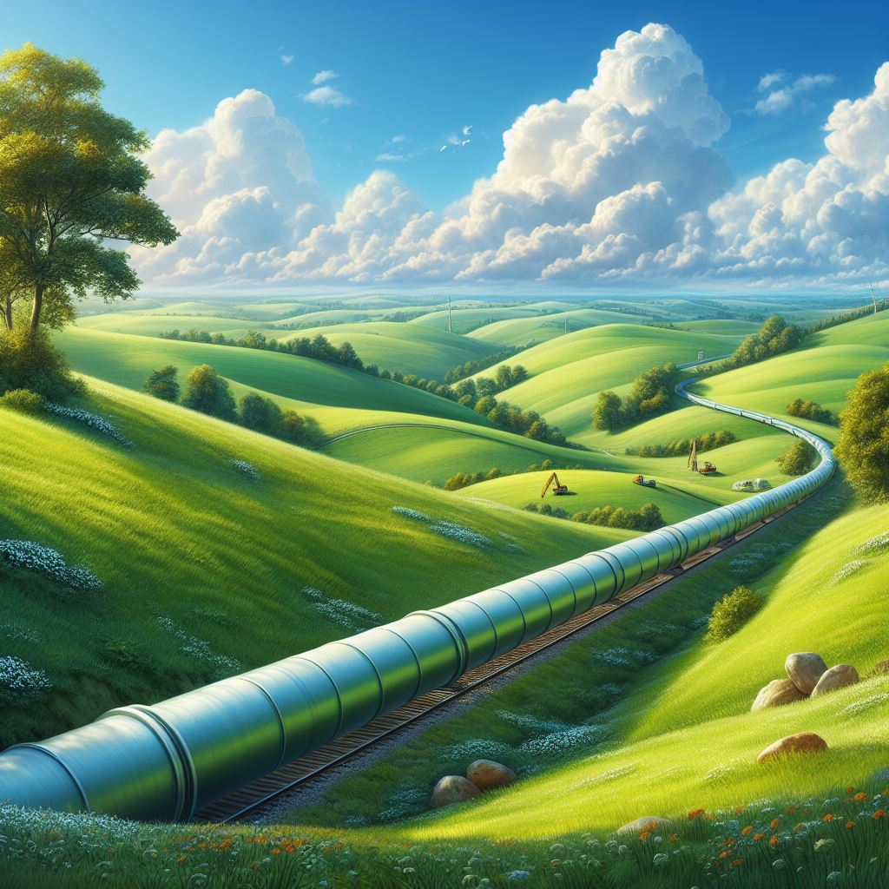
Energy Sources in Vancouver
Hydroelectric Power
Vancouver relies heavily on hydroelectric power, generated primarily from dams on nearby rivers. This clean energy source accounts for a significant portion of the city's electricity needs.
Natural Gas
While Vancouver has made strides in renewable energy, natural gas still plays a role in heating homes and powering industries. Efforts are underway to transition away from this non-renewable resource.

Slide 5


Transition to Renewable Energy
Solar Energy
The adoption of solar energy systems is increasing in Vancouver, particularly for residential and commercial properties. Solar panels harness sunlight to generate electricity, reducing reliance on fossil fuels.
Wind Energy
Vancouver's coastal location makes it well-suited for wind energy generation. Wind turbines installed in strategic locations harness the power of the wind to produce clean electricity for the city.

Slide 6
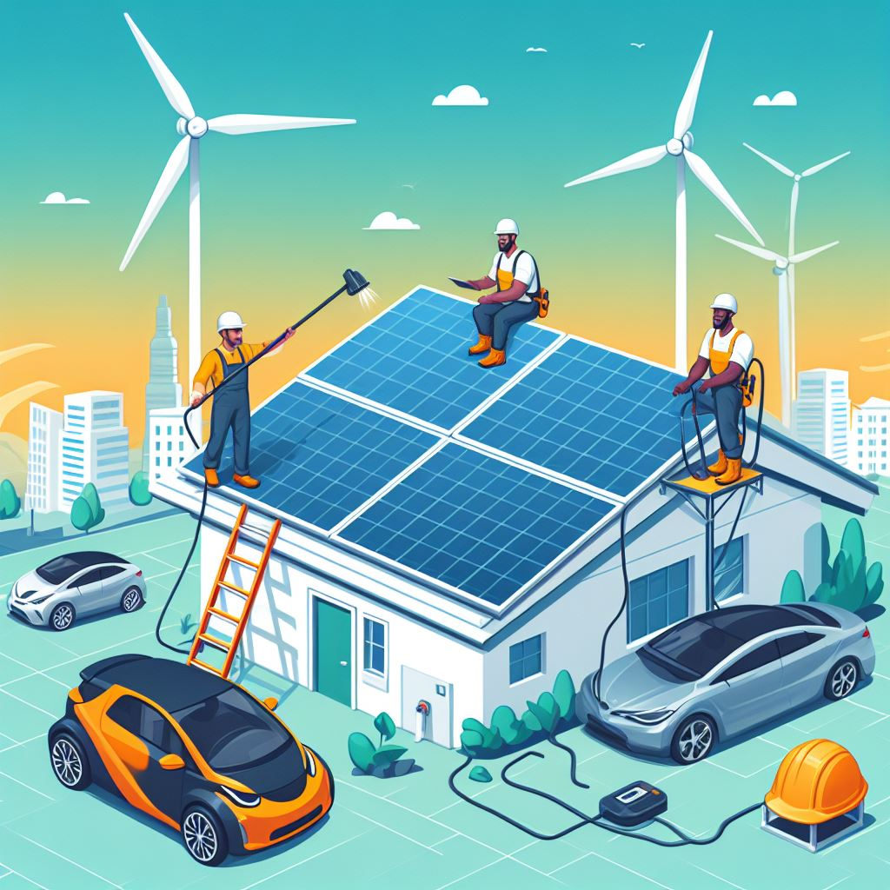
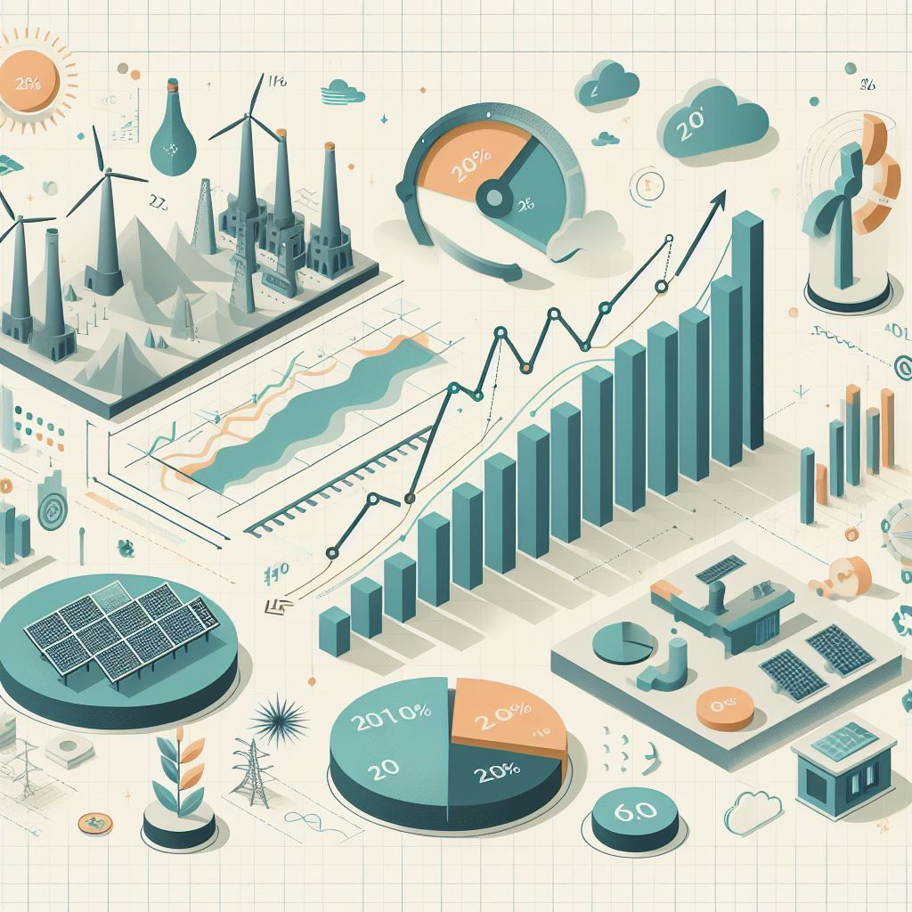

Local Strategies for Sustainable Energy
Decreasing Energy Use
Initiatives promoting energy efficiency in buildings and transportation aim to reduce overall energy consumption in Vancouver. This includes retrofitting buildings with energy-efficient technologies and promoting public transit.
Increasing Renewable Energy Use
Incentives and policies support the adoption of renewable energy technologies, such as rooftop solar panels and community solar projects. These efforts contribute to a more sustainable energy future for Vancouver.
Increasing Renewable Energy Supply
Investments in renewable energy infrastructure, such as expanding hydroelectric capacity and exploring tidal energy options, aim to increase the supply of clean energy in Vancouver and reduce dependence on fossil fuels.

Slide 7
Acknowledgments

